Slide 1

Cultivating Change: Data Insights on Agrifood Emissions
Giorgos Kastoras | Danai Vernadaki
03-02-2025

Slide 2
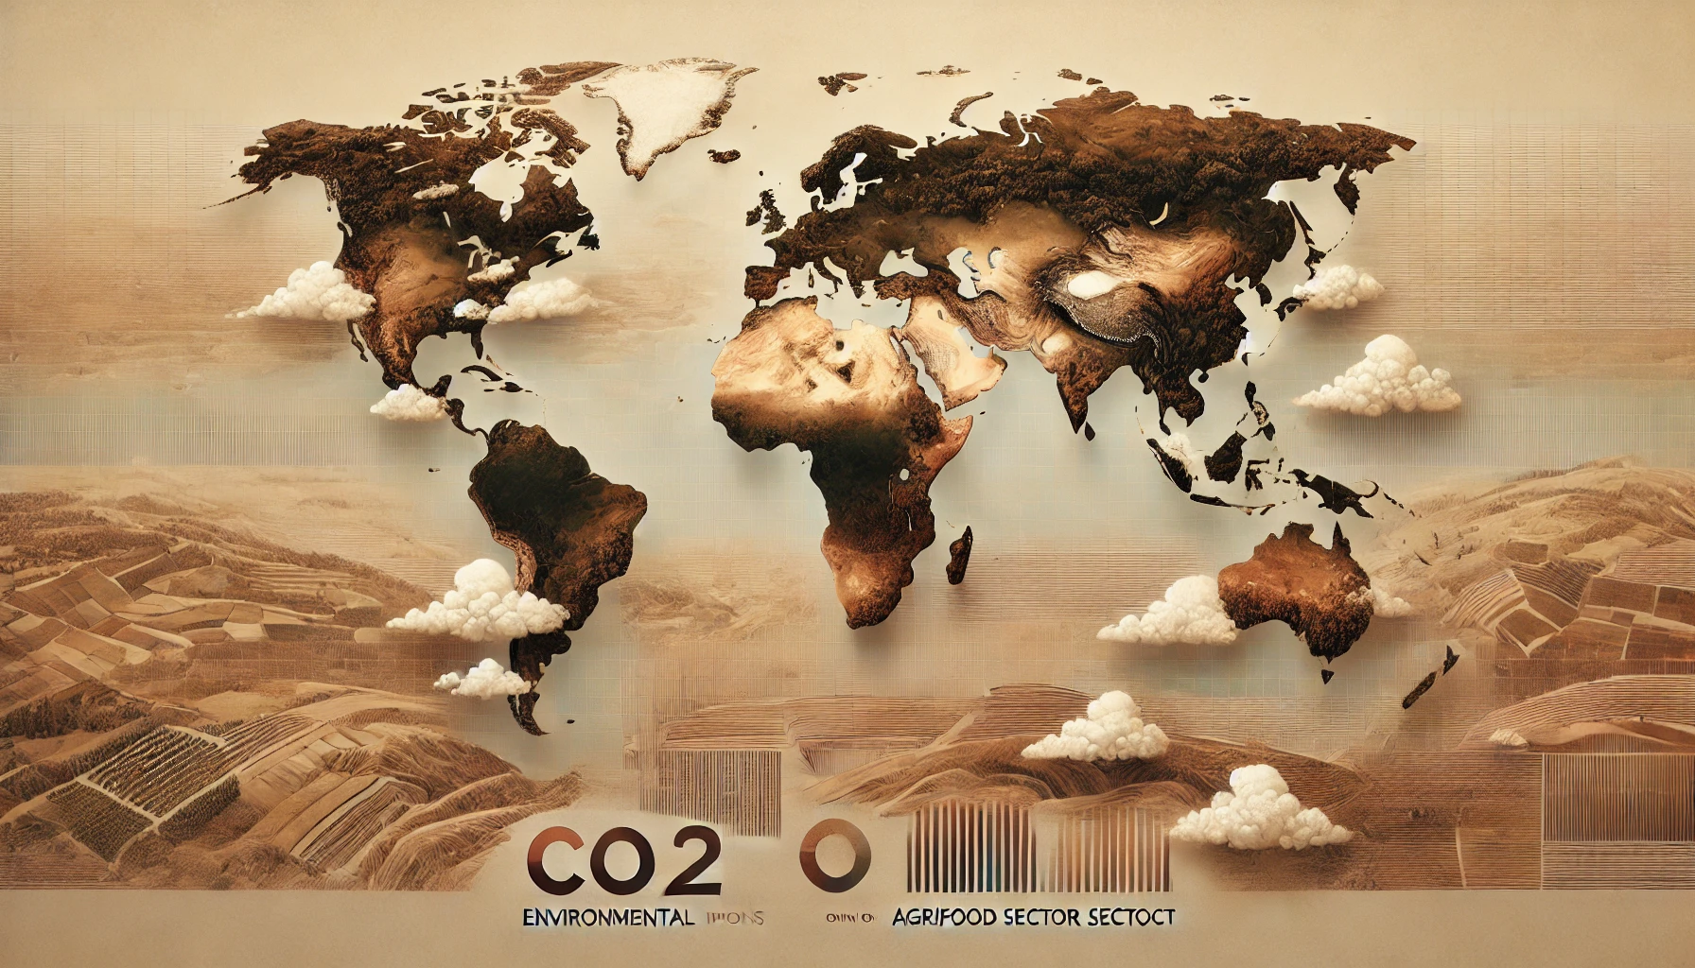


The team
Our goal is to identify actionable recommendations for policymakers, producers, and consumers to adopt more sustainable practices.

Slide 3
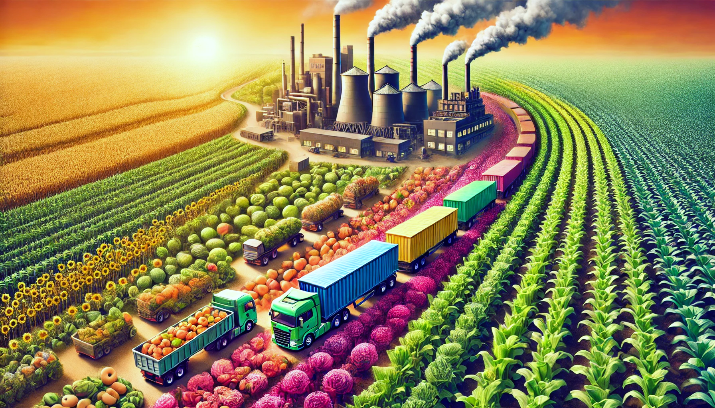
Introduction
Raise Awareness: Highlight the environmental impact of different agricultural activities and food production processes.
Promote Change: Provide data-driven insights to encourage the adoption of greener practices within the agrifood sector.

Slide 4
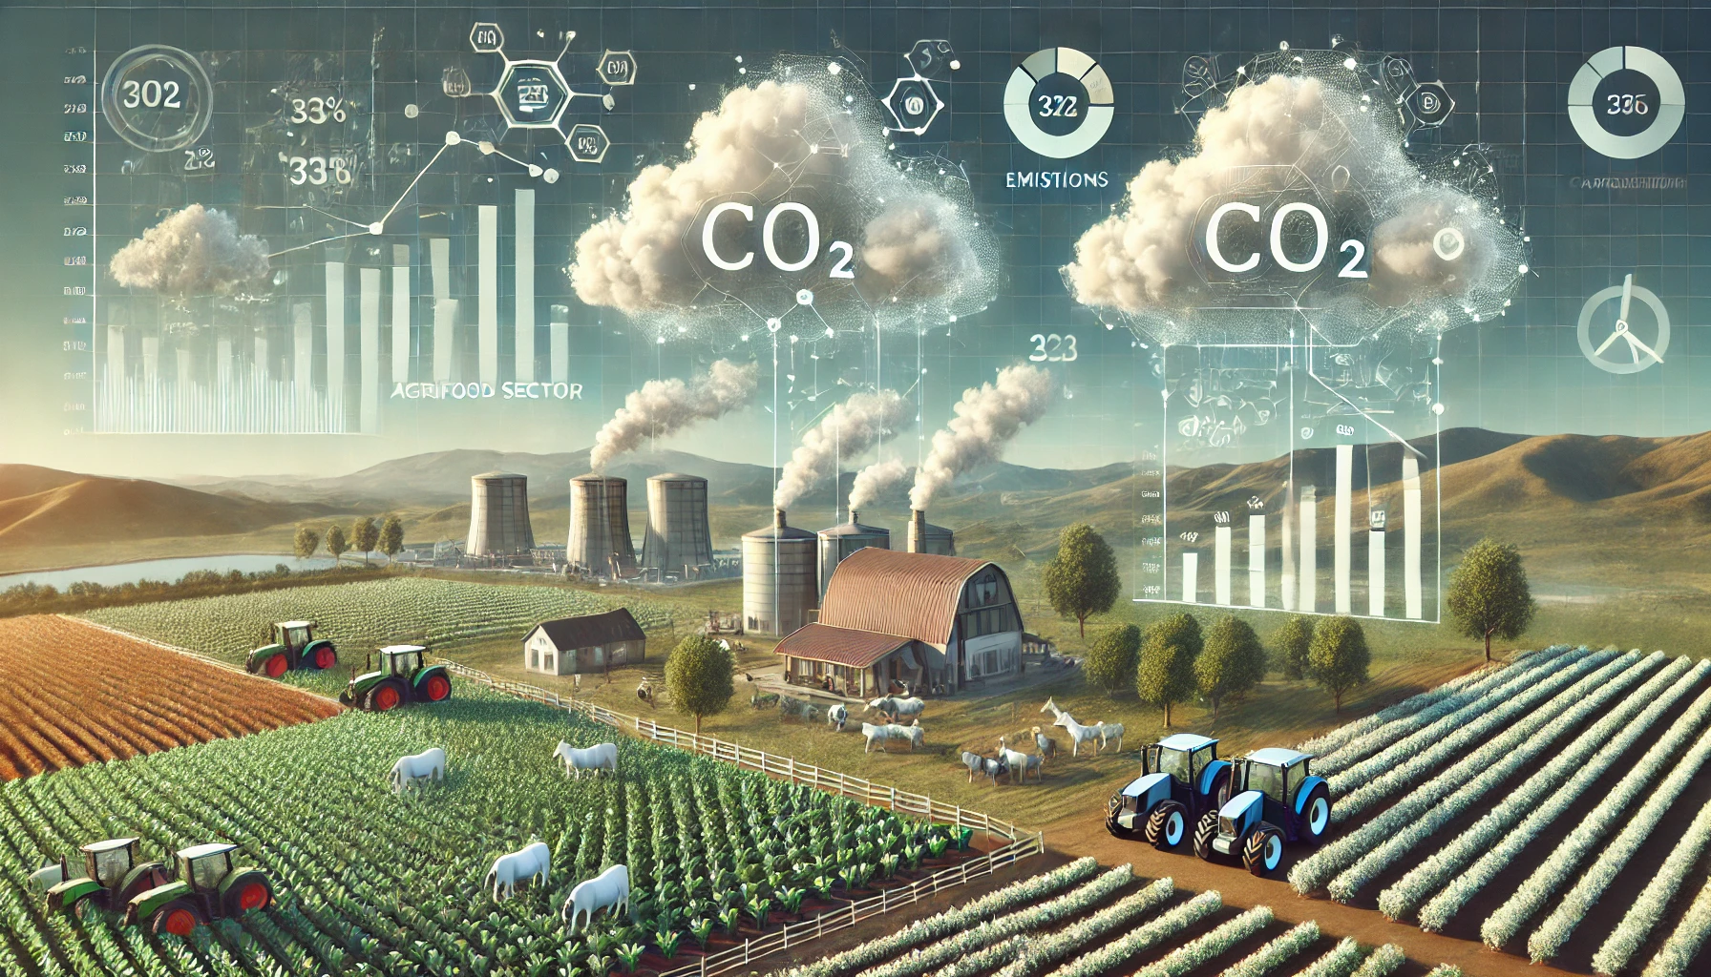


Data source
Kaggle
The agricultural CO2 emission dataset has been constructed by merging and reprocessing individual datasets from the Food and Agriculture Organization (FAO) and data from IPCC.
FAOStat
Sample of the dataset has been compared and verified with the data available at FAOStat

Slide 5




Dataset
Areas
CO2 Emission factors
192 countries & 38 territories
21
Rows & Col
Years
7k rows & 31 columns
31 (1990-2020)

Slide 6






Tools employed for the analysis
Pandas
Numpy
Matplotlib
Seaborn

Slide 7
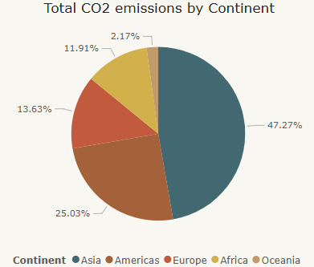
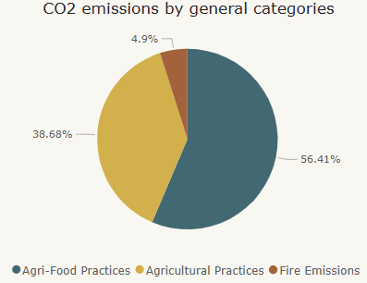
General Observations
~50%
~56%
Of the total CO2 emissions are from Asia
Of the total CO2 emissions are caused by Agri-Food System Related Practices

Slide 8
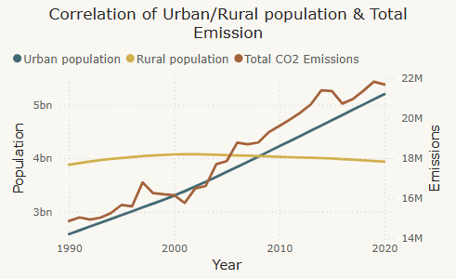
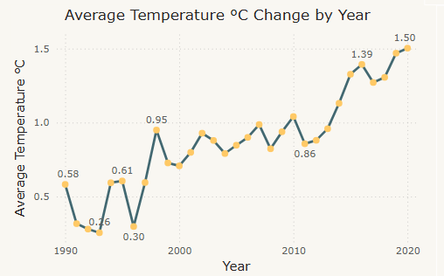
General Observations
Total CO2 emissions and Urban population show the same upward trend
The average temperature has increased by 1.5 degrees Celsius compared to pre-industrial time (FAO: base year 1961)

Slide 9
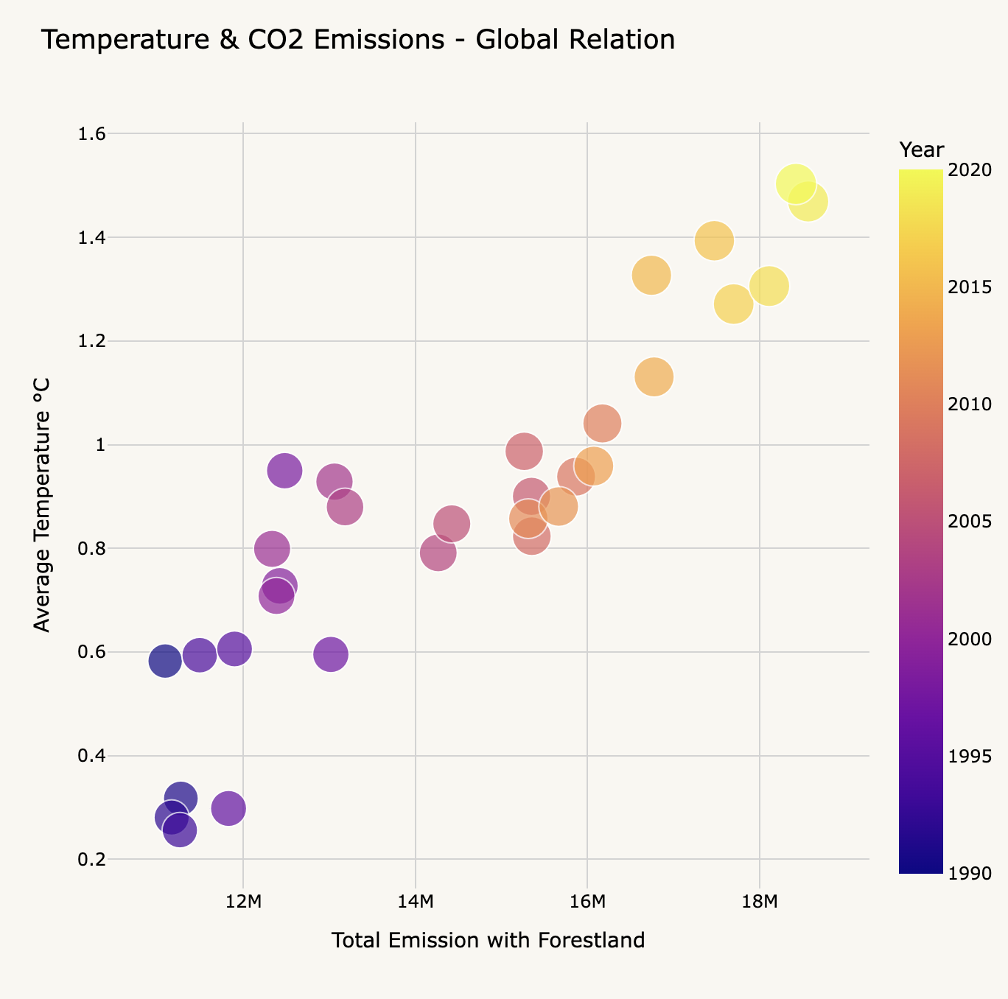
The Climate Equation: CO₂, Population, and Temperature Shifts
Strong Correlation: Over time, global CO₂ emissions and temperature rise together.
Population Influence: More people mean more emissions, mainly from food production.
Urbanization & Temperature: Growing populations and rising temperatures are strongly linked.

Slide 10
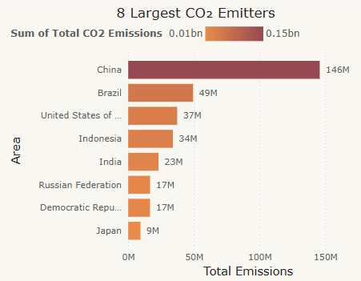
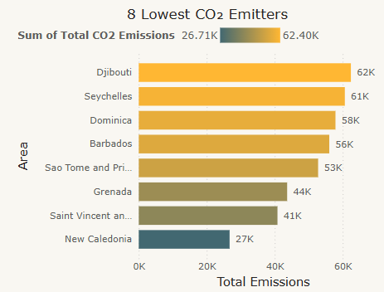
Largest & Lowest CO2 Emitters
China is the top emitter
New Caledonia is the lowest emitter
But it also has the largest population. Only Congo, is not among the top 10 most populous countries.
But not the least populated area.

Slide 11
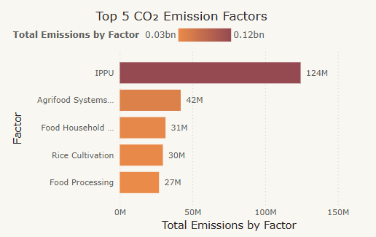
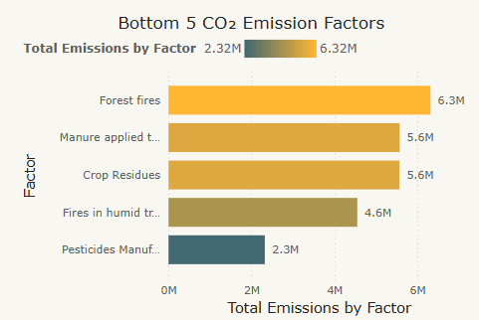
Top & Bottom CO2 Emission Factors
Emissions from industrial processes and product use is the most polluting factor
Pesticides Manufacturing is the least polluting factor
Followed by Fires in humid tropical places.
Followed by Agrifood Systems Waste Disposal and Food Household Consumption.

Slide 12
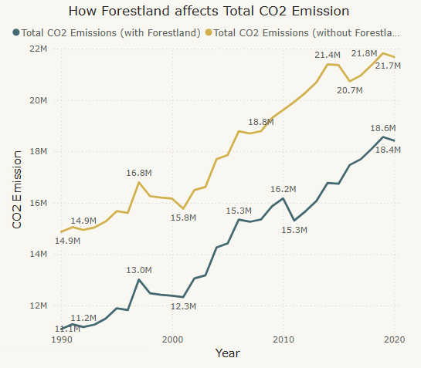
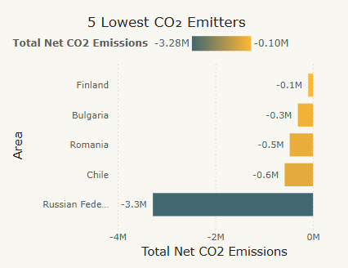
Importance of Forestland
Russian Federation: Approximately 49.8% of Russia's land area is forested, accounting for about 20% of the world's total forest area.
Chile: 24.3% of its land area
Romania: Approximately 30.1% of its land area
Bulgaria: 37.5% of its land area
Finland: 73.7% of its land area

Slide 13
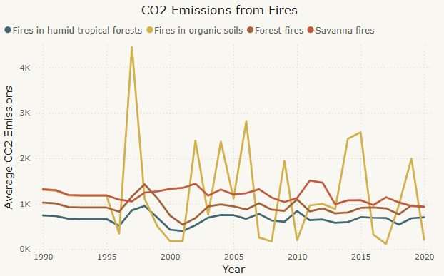
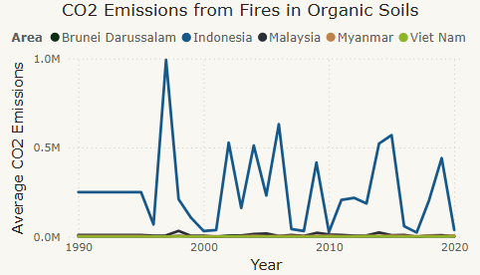
Tracking Fire-Related Emissions: Patterns and Variability Over the Years
Indonesian Peat Fires: In 1997, extensive peat and forest fires in Indonesia released between 0.81 and 2.57 gigatons of carbon, accounting for 40% of global fossil fuel emissions that year. These fires significantly contributed to the rise in atmospheric CO₂ levels.

Slide 14
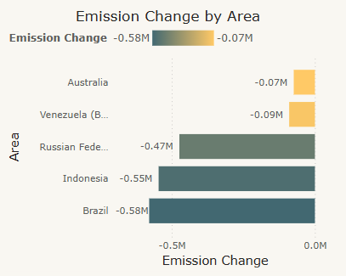
Learning from those who bring the change
Common Good Practices:
Sustainable Farming Practices
Reforestation Initiatives
Agricultural Modernization
Agroforestry Practices
Deforestation Prevention

Slide 15




Overcoming Barriers to CO₂ Reduction in Agrifood
Redirect Subsidies to reward sustainable practices
Farmer Education & Support
Consumer Awareness Campaigns
Carbon Pricing & Taxes
Investment in Green Technologies
Supply Chain Transparency

Slide 16

Thank you!
Agrifood impacts our environment more than we realize. If we act now, we can reduce emissions and shape a more sustainable future.
Will we continue on the same path, or will we cultivate change together?

Slide 17
ANNEX

Slide 18
Agri-food CO2 Emissions
Agricultural Practices
Agri-Food Practices
Crop Residues
Drained organic soils (CO2)
Manure applied to Soils
Manure left on Pasture
Manure Management
Rice Cultivation
Agrifood Systems Waste Disposal
Fertilizers Manufacturing
Food Household Consumption
Food Packaging
Food Processing
Food Retail
Food Transport
IPPU
On-farm Electricity Use
On-farm energy use
Pesticides Manufacturing
CO2 Emissions
Fire Emissions
Fires in humid tropical forests
Fires in organic soils
Forest fires
Savanna fires

Slide 19
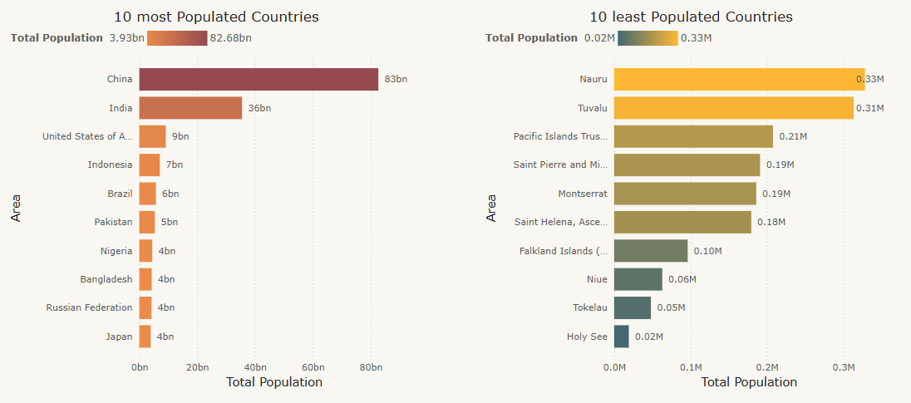
10 most and least populated Areas

Slide 20








Overcoming Barriers to CO₂ Reduction in Agrifood
Key Challenges Hindering CO₂ Reduction in Agrifood
Breaking Through The Barriers
Redirect Subsidies to reward sustainable practices
Economic Pressures on Farmers
Carbon Pricing & Taxes
Weak or Inconsistent Policies
Investment in Green Technologies
Resistance to Change and Knowledge Gaps
Farmer Education & Support
Supply Chain and Consumer Behavior
Consumer Awareness Campaigns
Land Use and Deforestation
Supply Chain Transparency

